Slide 1

90th Session
of the Committee on the Rights of the Child
Cambodia, Canada, Chile, Croatia, Cuba, Cyprus, Djibouti, Greece, Iceland, Kiribati, Somalia, Zambia

Slide 2
www.childrightsconnect.org
Fanny Chappuis, CRC Reporting & Programme Support
crcreporting@childrightsconnect.org

Slide 3

Child Rights Connect
www.childrightsconnect.org and crcreporting.childrightsconnect.org

Slide 4
Our Session Handbook
  Our session handbook :
  French: www.childrightsconnect.org/wp-content/uploads/2020/08/crcreporting_s_handbook_adults_fr.pdf
  English: www.childrightsconnect.org/wp-content/uploads/2020/08/crcreporting_s_handbook_adults_en.pdf
  Español: www.childrightsconnect.org/wp-content/uploads/2018/01/crcreporting_s_handbook_adults_es.pdf
  Please note: Some information may differ as it is not suitable for the online session

Slide 5
90th session: context
  Standard Reporting Procedure: Cambodia, Canada, Cuba, Cyprus, Djibouti, Greece, Iceland, Kiribati, Somalia
  Simplified Reporting Procedure: Chile, Croatia, Zambia
Country reviews will be held in hybrid modality online (4h) / in-person (6h):
      online : Canada, Greece and Kiribati
      in person: Cambodia, Chile, Croatia, Cuba, Cyprus, Djibouti, Iceland, Somalia, Zambia

Slide 6
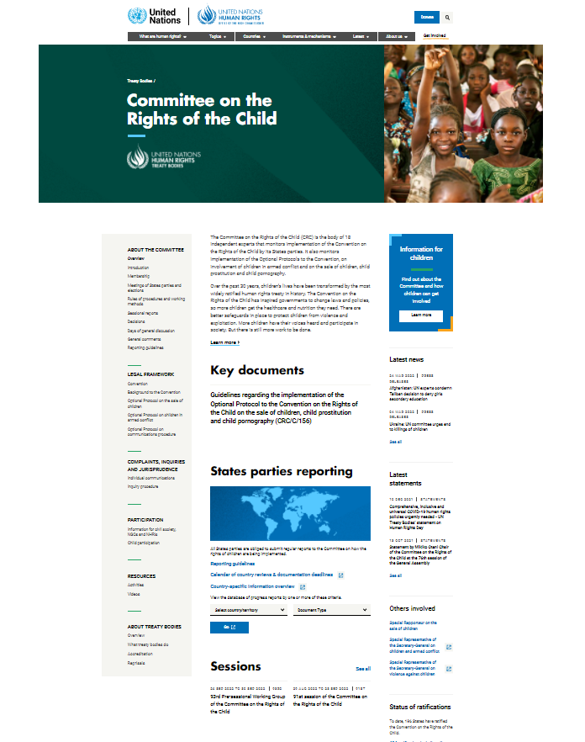
Dates
  Geneva timezone ⚠
  Opening: 03/05 at 10am
  Greece: 03/5 at 3pm - 04/05 at 10am
  Iceland: 04/05 at 3pm – 05/05 at 10am
  Cambodia : 05/05 at 3pm – 06/05 at 10am
  Somalia : 9/05 at 3pm – 10/05 at 10am
  Zambia: 10/05 at 3pm – 11/05 at 10am
  Cuba: 11/05 at 3pm – 12/05 at 10am
  Djibouti: 12/05 at 3pm – 13/05 at 10am
  Cyprus: 16/05 at 3pm – 17/05 at 10am
  Canada: 17/05 at 3pm – 18/05 at 3pm
  Kiribati: 18/05 at 9am – 19/05 at 9am
  Croatia: 19/05 at 3pm – 20/05 at 10am
  Chile: 24/05 at 3pm – 25/05 at 10am
  Closing: 3/06 at 5pm

Slide 7
Attend the dialogues in person
  Register on Indico (compulsory, even holders of UN badges)! https://indico.un.org/event/36595/
  Please let us know if you plan to attend the session in person!

Slide 8
State delegation participation
The composition is available on the CRC session website under:
"List of delegation/participants” for each country session

Slide 9
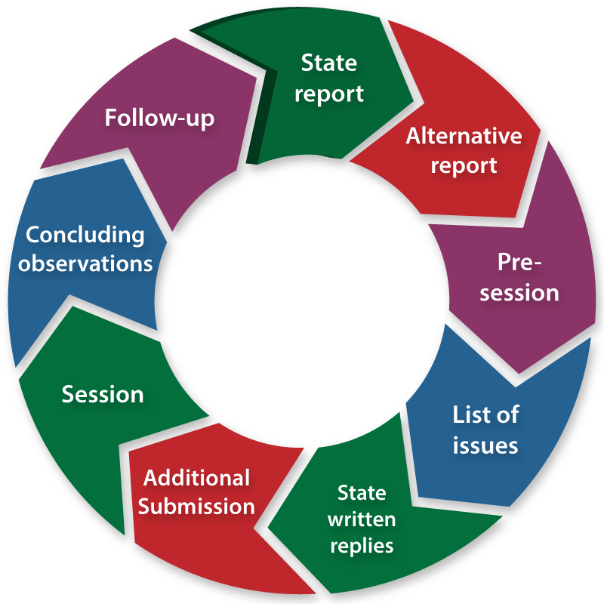
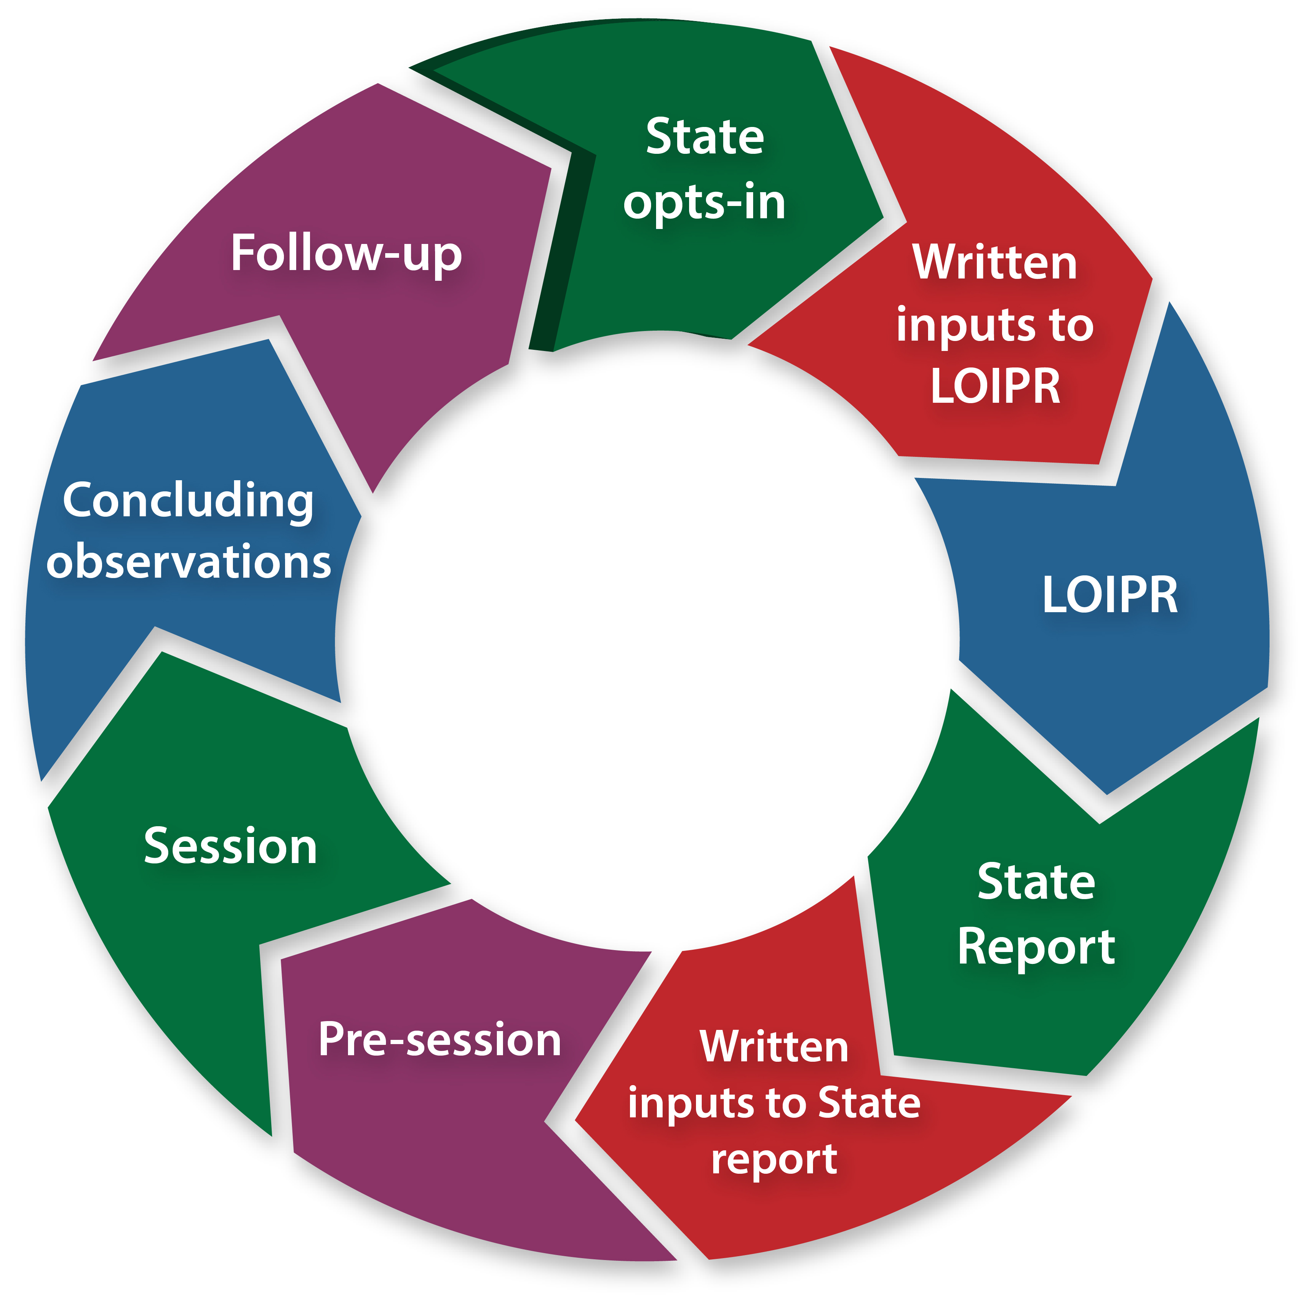
The Committee's reporting cycle
Public Meeting
Interactive dialogue between the Committee and the government
Great advocacy tool!
Joint activities at national level
Standard Reporting Cycle
Simplified Reporting Cycle​

Slide 10
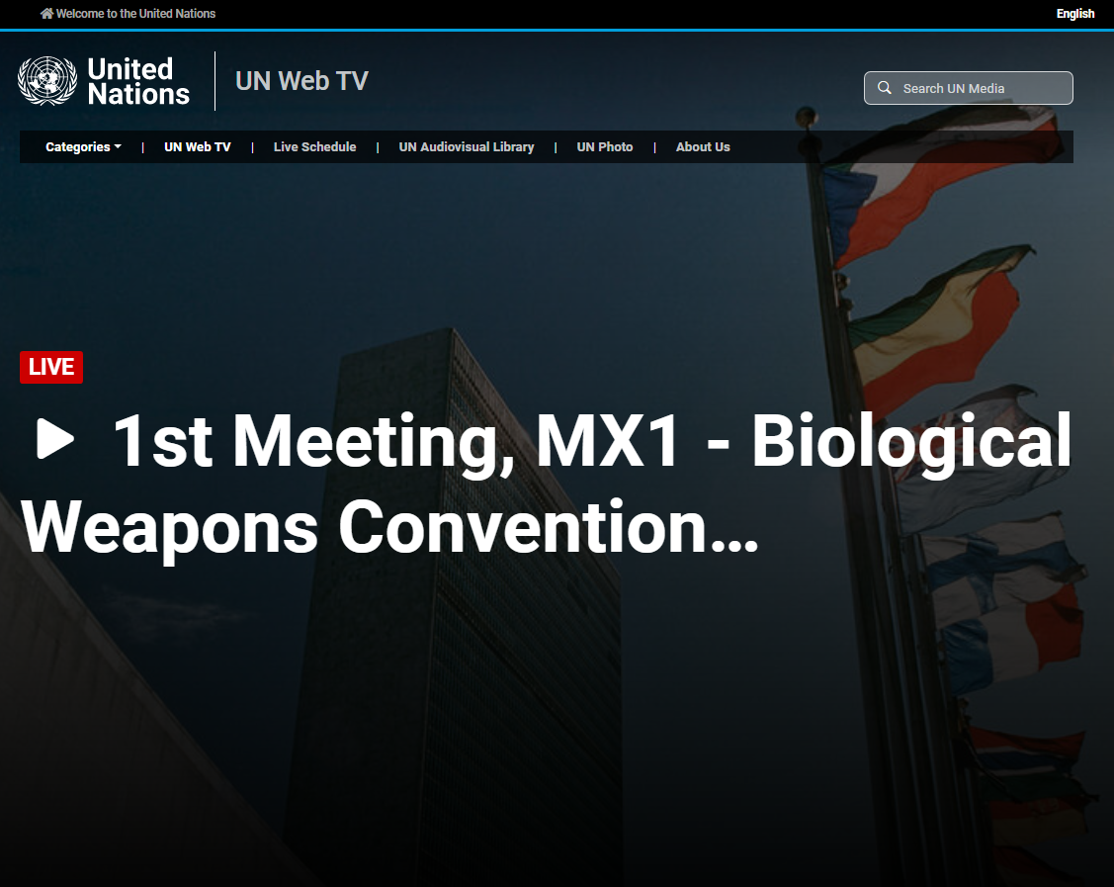
Follow the dialogue
Follow the dialogues live on the UN web TV: http://webtv.un.org/
  Languages: English, French, Spanish

Slide 11
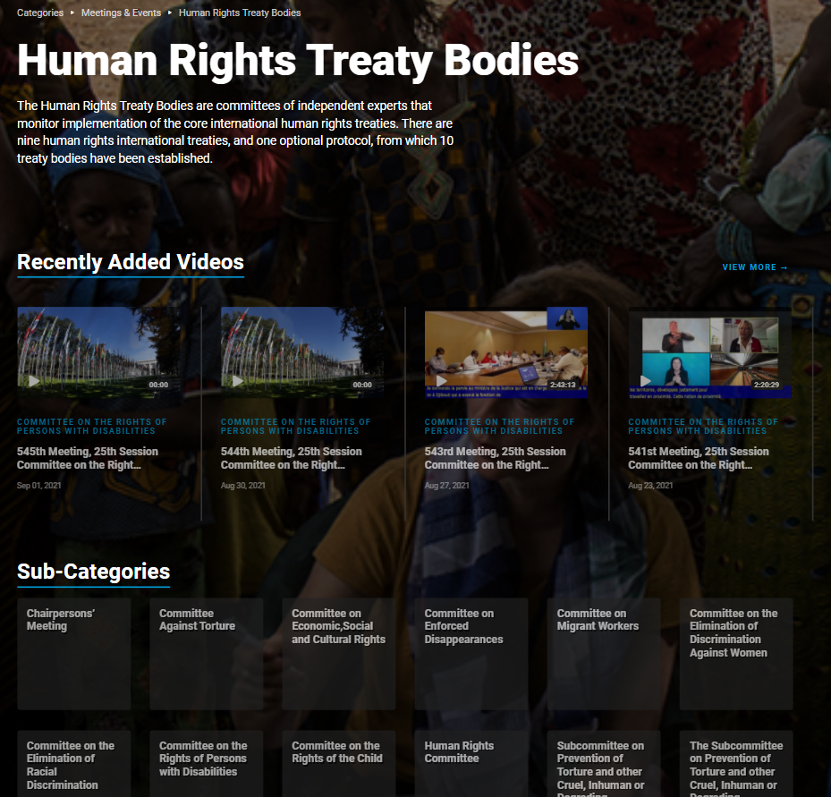
Follow the dialogues
  Rewatch the dialogues on the UN web TV:
  http://webtv.un.org/

Slide 12
Attend the dialogues in person
  Register on Indico (compulsory, even holders of UN badges)! https://indico.un.org/event/36595/
  Please let us know if you plan to attend the session in person!

Slide 13
Structure
First part (2 or 3 hours)
Introduction:
Opening remarks by the Chairperson
Opening statement by the State delegation
Questions & answers:
First round of questions on the first 5 clusters of rights
10-15-minute break
Government’s responses and follow-up questions from the Committee
Second round of questions from the Committee on the 4 other clusters of rights
Second part (2 or 3 hours)
Government’s responses
Final questions from the Committee and answers from the Government
Conclusions:
Concluding remarks from the Committee and the State party

Slide 14
Country Task Force
Countries | Committee members | Countries ​ | Committee members
CAMBODIA | Mikiko Otani (coordinator) | CUBA | Faith Marshall-Harris (coordinator)
 | Suzanne Aho Assouma |  | Benyam Dawit Mezmur
 | Rinchen Chophel |  | Clarence Nelson
 | Ann Skelton |  | Luis Pedernera
CYPRUS | Bragi Guðbrandsson (coordinator) | DJIBOUTI | Aïssatou Alassane Sidikou (coordinator)
 | Hynd Ayoubi-Idrissi |  | Philip Jaffé
 | Sophie Kiladze |  | Benoit van Keirsblick
 | Faith Marshall-Harris |  | Ratou Zara

Slide 15
Country Task Force
Countries | Committee members | Countries ​ | Committee members
GREECE | Velina Todorova (coordinator) | SOMALIA | Hynd Ayoubi-Idrissi (coordinator)
 | Gehad Madi |  | Philip Jaffé
 | Mikiko Otani |  | José Rodrigues Reyes
 | Benoit van Keirsblick |  | Ratou Zara
KIRIBATI | Philip Jaffé (coordinator) | CROATIA | Benyam Dawit Mezmur (coordinator)
 | Aïssatou Alassane Sidikou |  | Rinchen Chophel
 | Clarence Nelson |  | Sophie Kiladze
 | José Rodrigues Reyes |  | Velina Todorova

Slide 16
Country Task Force
Countries | Committee members | Countries ​ | Committee members
CANADA | Ann Skelton (coordinator) | ZAMBIA | Gehad Madi (coordinator)
 | Hynd Ayoubi-Idrissi |  | Suzanne Aho
 | Bragi Guðbrandsson |  | Rinchen Chophel
 | Faith Marshall-Harris |  | Ann Skelton
ICELAND | Luis Pedernera (coordinator) | CHILE | Clarence Nelson (coordinator)
 | Benyam Dawit Mezmur |  | Luis Pedernera Reyna
 | Sophie Kiladze |  | Aïssatou Sidikou
 |  |  | Velina Todorova

Slide 17
Live comments
  During the dialogue, send your critical comments to crcreporting@childrightsconnect.org
  Please send something very to the point and brief

Slide 18
Social Media
  Twitter et Facebook : @ChildRightsCnct
  Some @ and hashtags to follow or use:
  #ChildRights
  #CRC
  #CRC90
  #OPSC - #OPAC - #OPIC
  #ChildParticipation
  #CHRDs
  #Cambodia #Canada #Chile #Croatia #Cuba #Cyprus #Djibouti #Greece #Iceland #Kiribati #Somalia #Zambia
  #HumanRights
  @ChildRightsCnct @UNChildRights1 @UNHumanRights @UNGeneva

Slide 19
Children's participation during the session
  Moldova case study: Webcasting as an opportunity for children to engage in the session
  https://childrightsconnect.org/wp-content/uploads/2018/01/CASE-STUDY_Moldova_SessionWebcast_2019.pdf

Slide 20
Concluding Observations
Public document
Recommendations
Contains up to 6 urgent measures

Slide 21
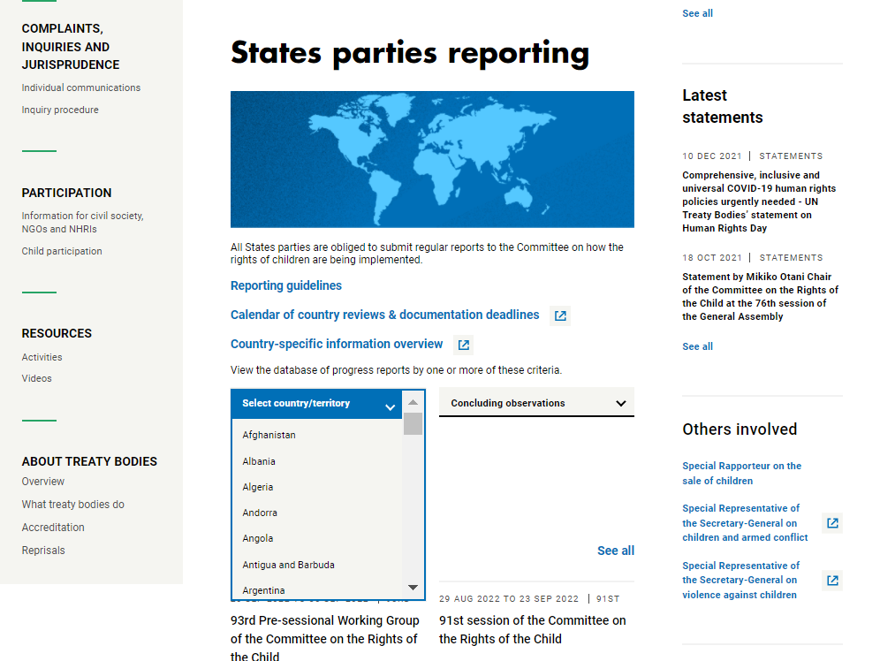
Concluding Observations

Slide 22
Info pack
  Child Rights Connect's info pack
  An update on the status of ratifications
  Country Reports: Summary of the dialogues including the main issues raised and recommendations of the Committee's concluding observations for each country
  Summary of the Committee's main activities during the session
  Summary of the main activities of Child Rights Connect during the session
  The info pack will be available shortly after the end of the session at: www.childrightsconnect.org/crc-sessions-and-webcasting/

Slide 23
Follow-up
Objective: Implement positive changes for children's rights
5 years
Multiple opportunities to engage and influence
  The cycle does not and should not end there!

Slide 24
Between two reviews: follow-up
  1. Advocacy activities
  2. Developing tools to monitor and measure the implementation progress
  3. Working with the government
  4. Organising a follow-up visit by Committee Members
  5. Engaging with other Human Rights Treaty Bodies and UN mechanisms
  6. Maintain collaboration with other organisations!

Slide 25

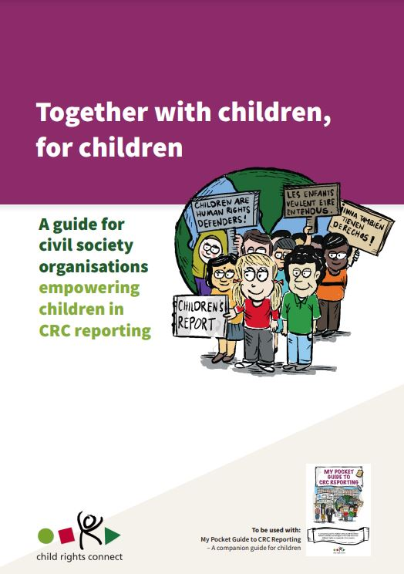
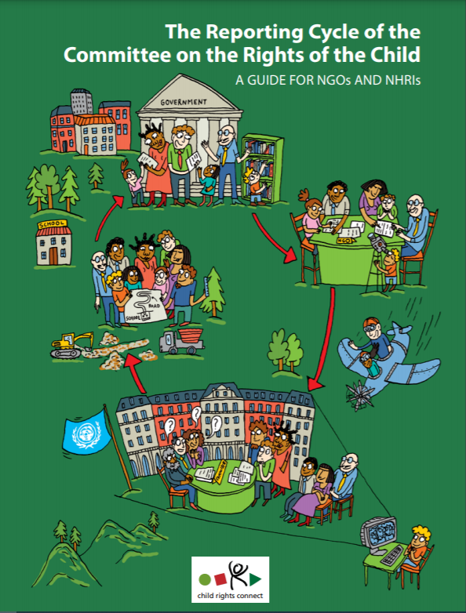
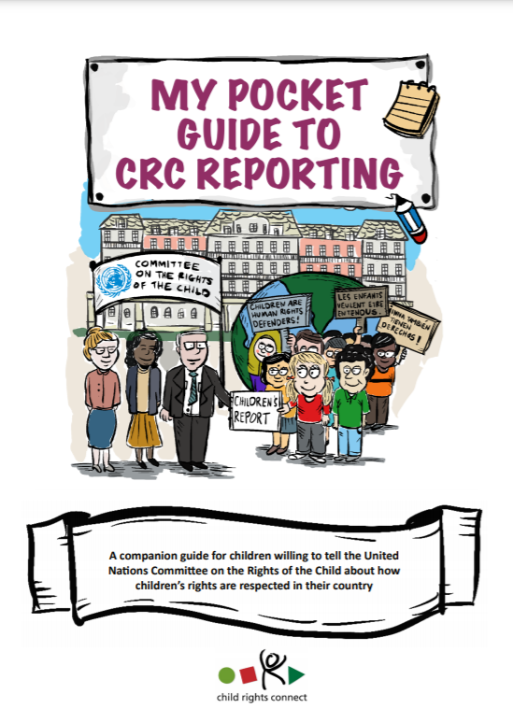
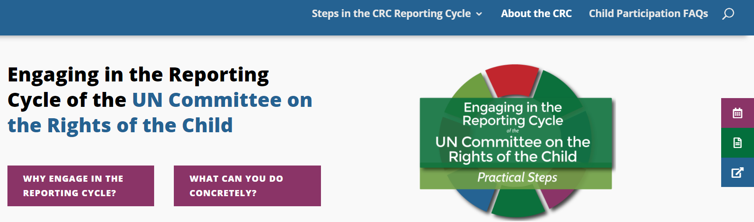

Slide 26
Thank you for your attention!
Any questions?
Q&A
or
crcreporting@childrightsconnect.org

