Slide 1
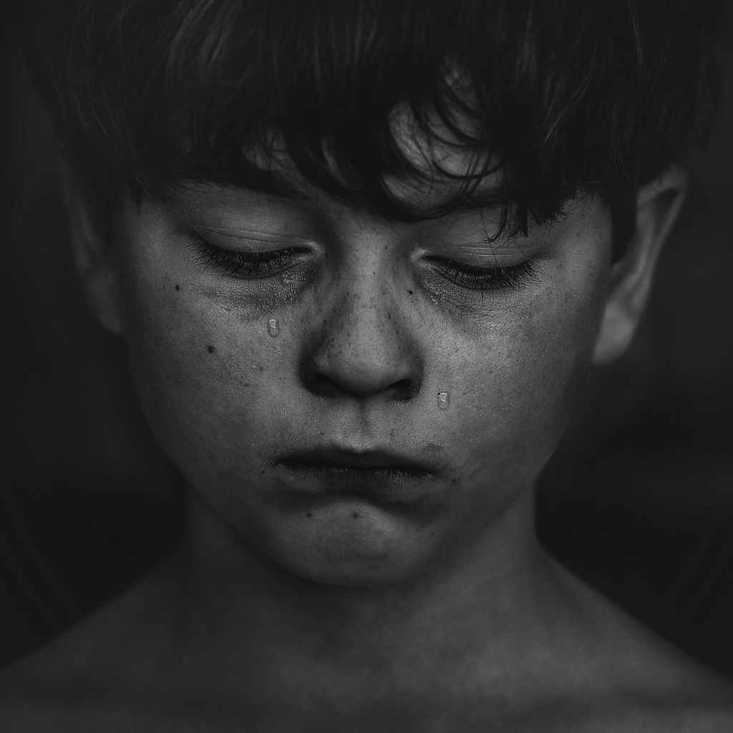
The Canadian Model of Community Social Pediatrics
A Child-Rights Based Approach to Child Health
Dr Gilles Julien, CM.,O.Q.
Social Pediatrician
Founder, Community Social Pediatrics
CCCR. 13 October 2023
Notes:
Gilles 1
This is a rallying cry for the future of children who are in a vulnerable state of health; a tragedy that is preventable through a response to preventing brain damage in numerous young children.

Slide 2
Two goals
1-Understanding The innovative practice of
community social pediatric
2-Recognizing the added value of the child’s active participation in the decision-making process regarding his/her global heath status and needs for support and treatment

Slide 3
Vulnerable children
Those who can be hurt and damaged through different causes
in their heart, body and soul, leading to a severe risk to impede their full developement and health

Slide 4
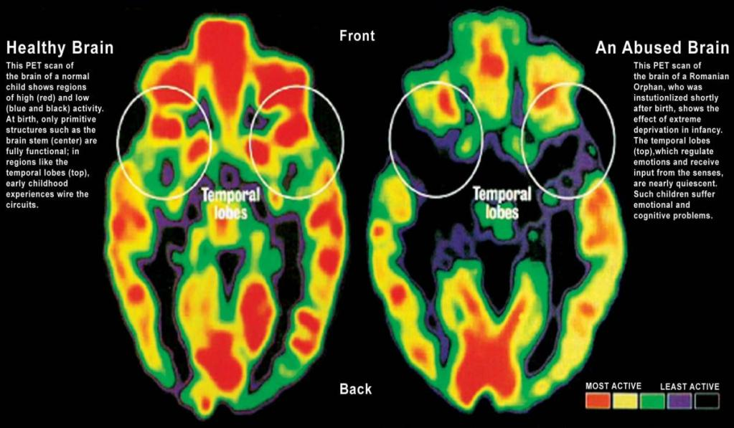
A Brain Shutting Down
Source: The Impact of Neglect on the Developing Brain - Simply Fostering Consultancy

Slide 5

The Tragedy
Increasing number of vulnerable children all over the world
because of complex trauma, cumulative toxic stresses and adversity
High Risk of brain damage and negative genetic transformation
Health and development failures
Many children falling into cracks
Compromised future
© All rights reserved, Fondation Dr Julien, Child’s Rights Approach to Child Health, October 2023

Slide 6
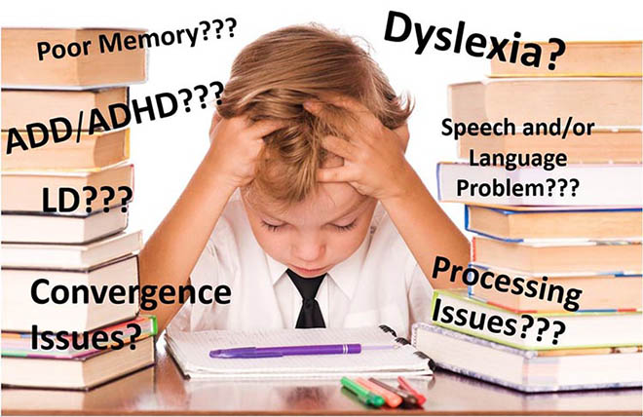
Some serious consequences
Cette photo par Auteur inconnu est soumise à la licence CC BY-SA-NC
© All rights reserved, Fondation Dr Julien, Child’s Rights Approach to Child Health, October 2023
Notes:
Gilles 2

Slide 7
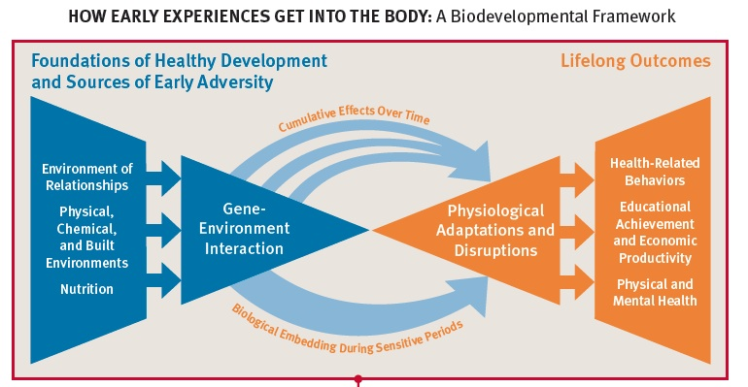
Early adversity affects the child’s development to adulthood - as Reflected by the Centre of Developing Child Harvard University, 2013
The tragedy | The Canadian model of community social pediatrics | The impact & extent of community social pediatrics
© All rights reserved, Fondation Dr Julien, Best Brains Exchange, October 2018

Slide 8
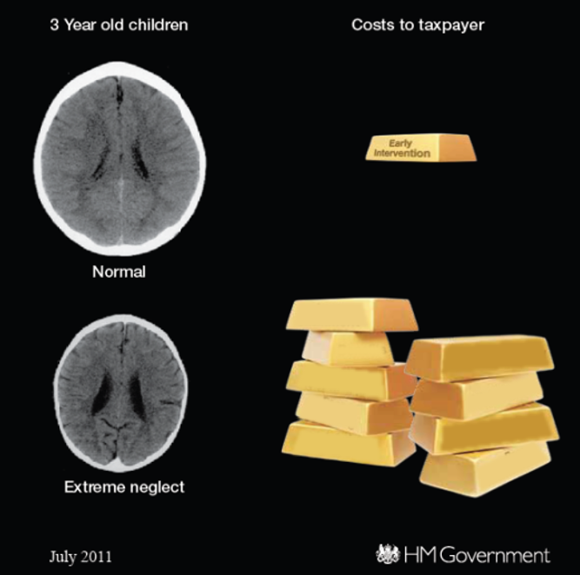
The Issue
Repairing at high-cost vs preventing at low cost
“It is easier to build strong children….then to repair broken men.”
- Frederick Douglass

Slide 9

A Child’s Right approach to Health is…
“…interdependent with other rights and requires that the design of medical interventions and delivery strategies to address their health needs be holistic and integrated with the work undertaken by other disciplines if they are to be effective and sustainable.”
(John Tobin, 2011)
© All rights reserved, Fondation Dr Julien, Child’s Rights Approach to Child Health, October 2023

Slide 10
Community social pediatric
A unique transdisciplinary approach of care and services that integrates medecine, law and psychosocial services
An approach based on the respect of the all the rights of the child (41 rights, 7 principles)
An approach that creates a proximal connection and an active participation of the child in all decisions concerning his/her health and life
An approach focusing on impowering children, families and communities to develop a protective and supporting circle around the child

Slide 11
The Community Social Pediatrics Approach
An innovative clinical method based on the UN Convention on the Rights of the Child, evidence-based neuroscience and global needs of the child
Establishing a special relationship (proximity)
Getting to know each other and building a relationship of trust to work in partnership.
Exchanging (Interaction)
Sharing, speaking with the child, their family and those around them and allowing emotions, facts or ideas to be expressed without prejudice or judgement.
Decoding (active human intelligence)
Using an integrated approach to analyze everyone’s understanding and experiences in order to decode the meaning of a problem and decide what steps to take next.
Action
Creating and implementing an intervention plan with the child, involving their extended family and the community and ensuring follow-up.
© All rights reserved, Fondation Dr Julien, Child’s Rights Approach to Child Health, October 2023
Notes:
Voici la nouvelle diapo de Dr Julien:
A rallying cry for the future of vulnerable children
A response for the Tragedy of preventable brain damage in numerous young children
The innovative APCA method in Community social pediatrics based on the UN convention of the rights of children and on evidence-based science
4 steps:
A for attachement and trust (how to be)
P for problem sharing and decoding to deepen into the causes
C for a comprehensive transdisciplinary approach (medical, legal, social sciences, family and child as full partners)
A for action to be created out of the box by all participnts in a consensus mode (how to do)

Slide 12
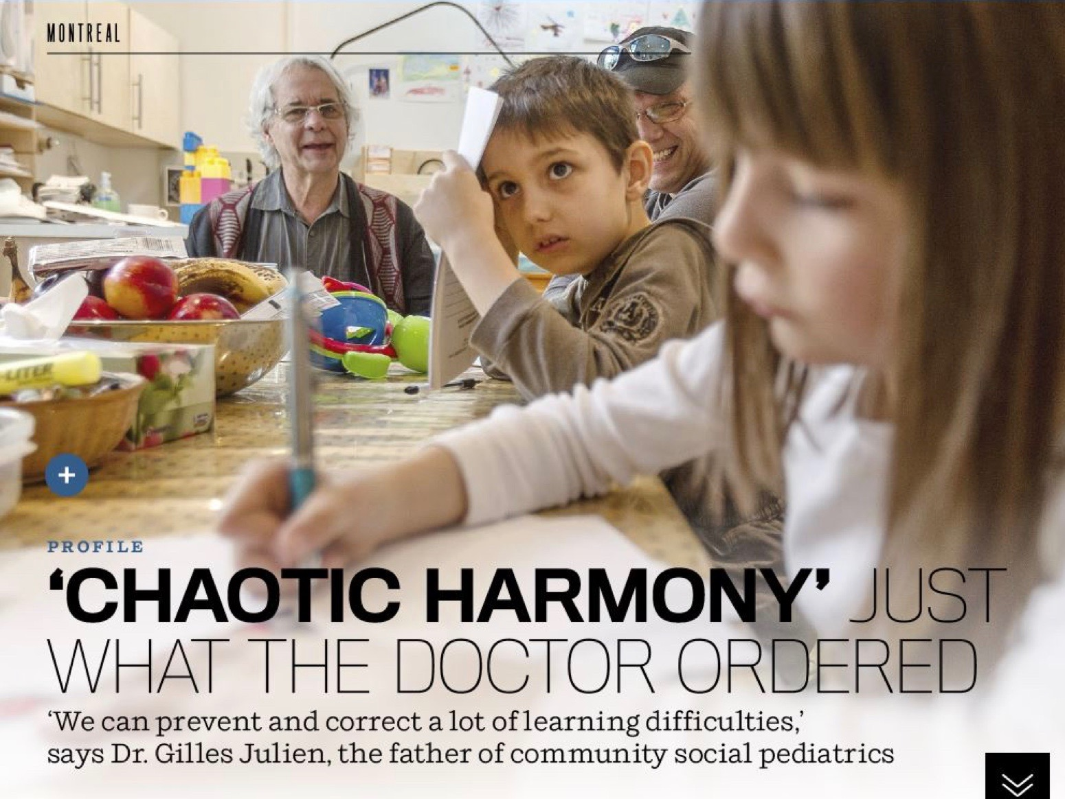
Thinking and acting out of the box = EEDA
Establishing a relationship with the child & family (caregivers), partners and getting to know each other
Exchanging - Sharing issues and common goals with participants
Decoding and understanding the roots of symptoms and the causes of suffering
Acting and developing a shared action plan based on priorities and unmet fundamental rights (CRC).
© All rights reserved, Fondation Dr Julien, Child’s Rights Approach to Child Health October 2023
Notes:
Gilles 3
Throughout my 50 years of practising pediatric, I have developed a four steps approach, especially for children in needs,
To obtain pertinent clinical information in order to meet children’s needs, the practitioner in community social pediatrics resorts to the APCA (EEDA) method, a scientific evidenced based approach in health.
It is similar to the approach of the conflict circle as depicted by Christopher Moore. In summary, one cannot deal with the problem, before dealing with emotions, and sharing the facts.

Slide 13

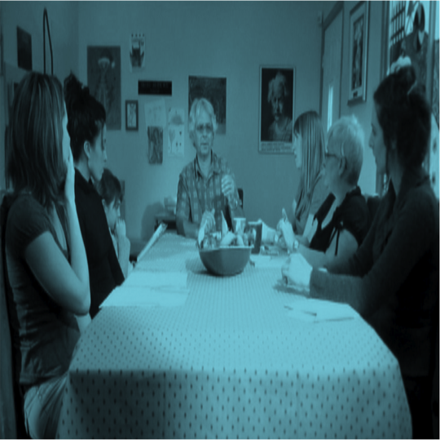
Inviting the child’s networks & community partners to work together
no. 1
© All rights reserved, Fondation Dr Julien, Child’s Rights Approach to Child Health, October 2023
Notes:
Gilles 4
In Community social pediatrics, the doctors does not evaluate the child alone. He or she works with a team (social worker and lawyer trained in mediation). It also requires the presence of the child, of the parents, of those who are invited by the family, of the community partners involved in the family’s life.

Slide 14
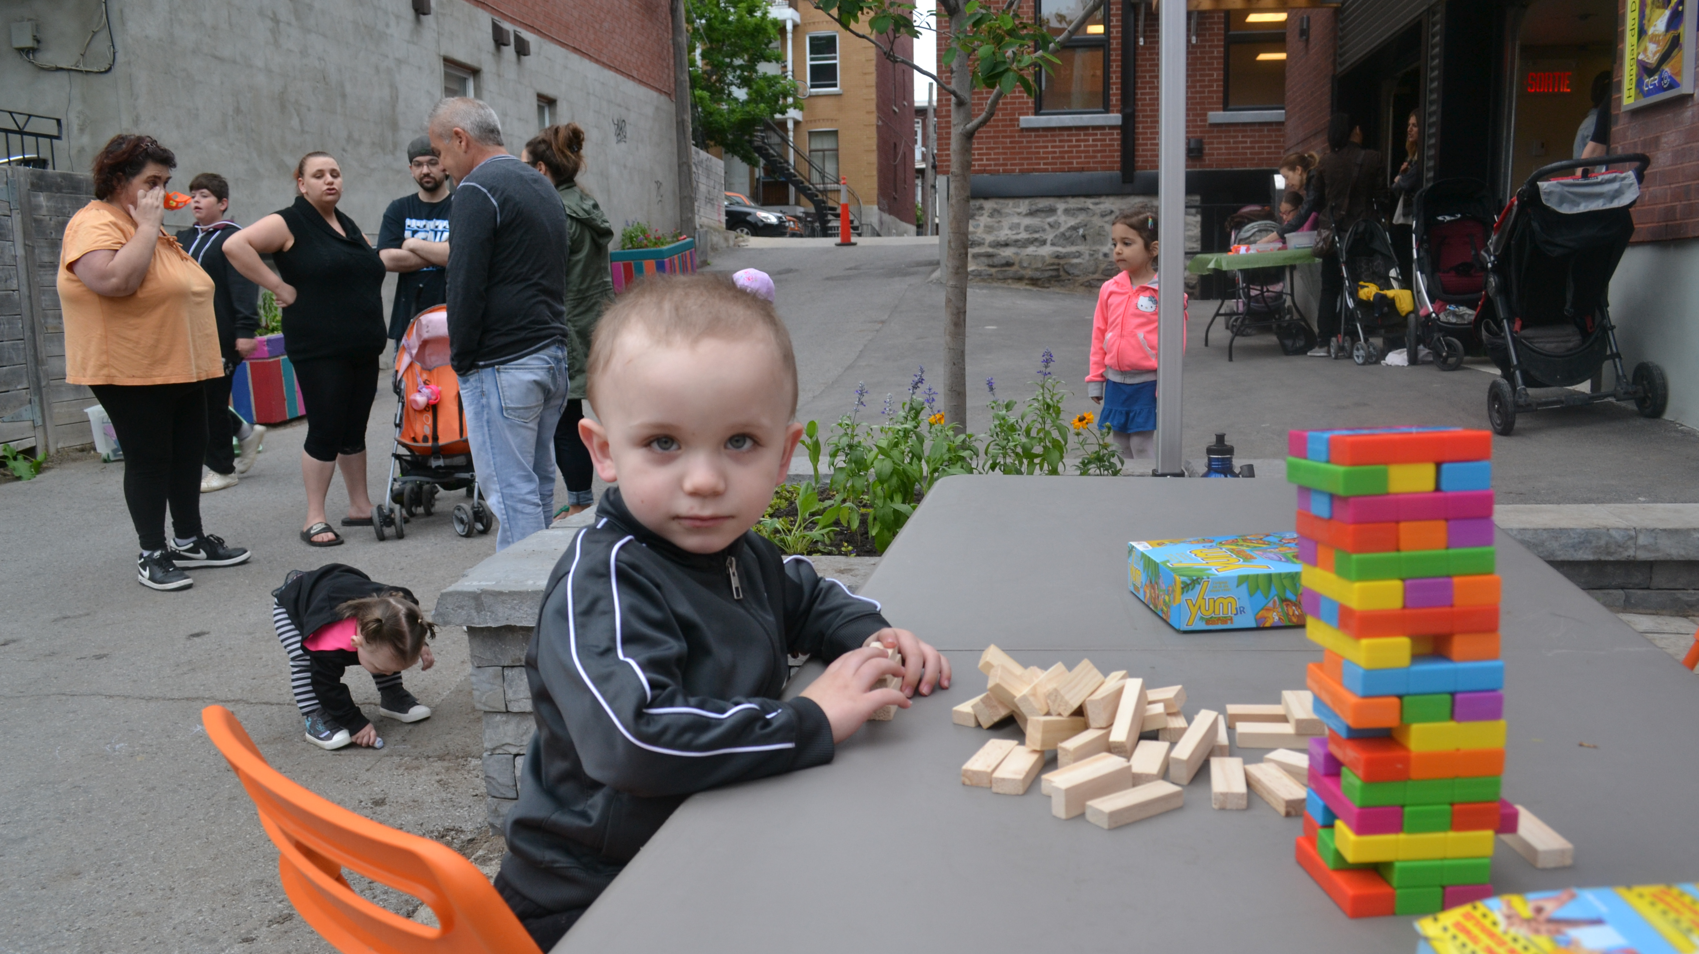
Respecting the child as a complete human being and taking our lead from the child
no. 2
© All rights reserved, Fondation Dr Julien, Child’s Rights Approach to Child Health, October 2023
Notes:
Gilles 5

Slide 15
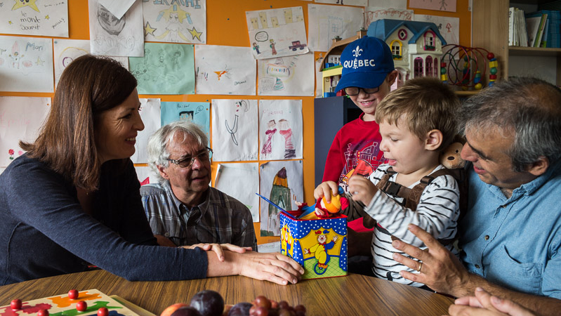

Practicing the art of decoding verbal & nonverbal language of the child
no. 3
Now Available in english
© All rights reserved, Fondation Dr Julien, Child’s Rights Approach to Child Health, October 2023
Notes:
Gilles 6

Slide 16


Adopting a transdisciplinary approach to ensure cohesion in care & services
no. 4
HEALTH
Family Network
Needs, Interests, Strengths
Education (Day care & schools)
Health determinants
Social services (Youth Protection)
CHILD’S INFORMED PARTICIPTION
CHILD’S INFORMED PARTICIPANT
LAW
Justice (Court, police services, lawyers)
Children’s rights
Culture and Leisure
Environment
PSYCHOSOCIAL
© All rights reserved, Fondation Dr Julien, Child’s Rights Approach to Child Health, October 2023
Notes:
Gilles 7
A team work and a local networks mobilisation
Identifying and meeting all children’s needs / rights / interests and strenghts

Slide 17
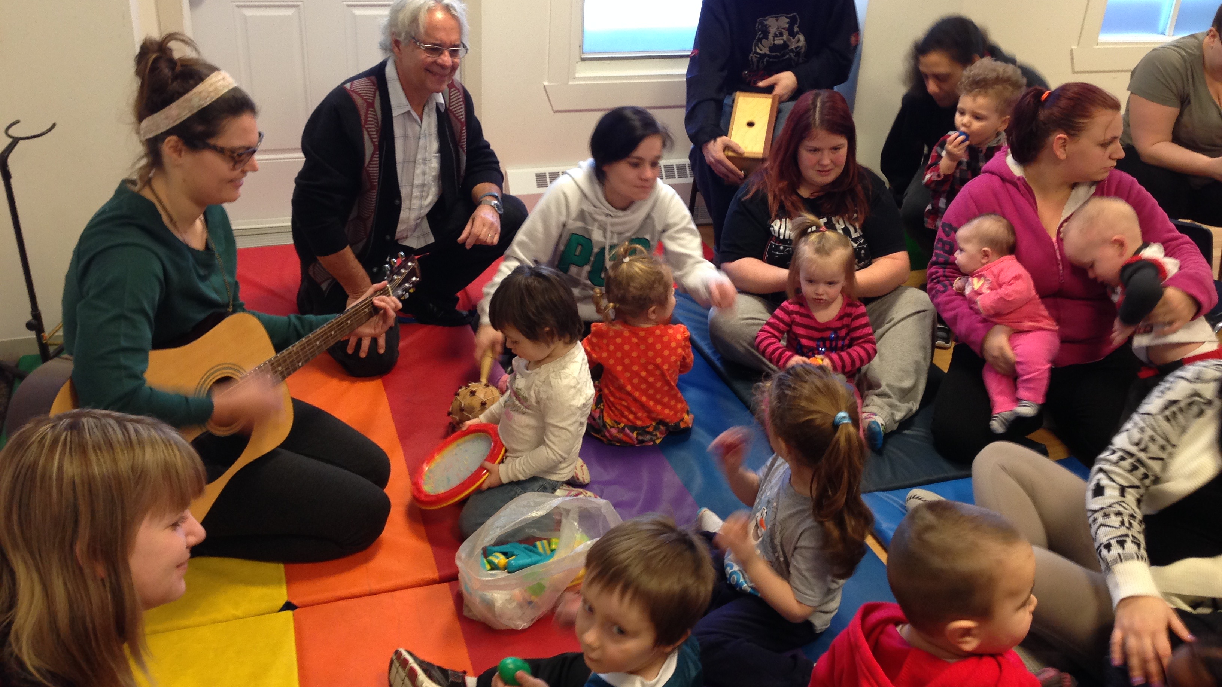
Mobilizing the family network
no. 5
© All rights reserved, Fondation Dr Julien, Child’s Rights Approach to Child Health, October 2023
Notes:
Gilles 8

Slide 18
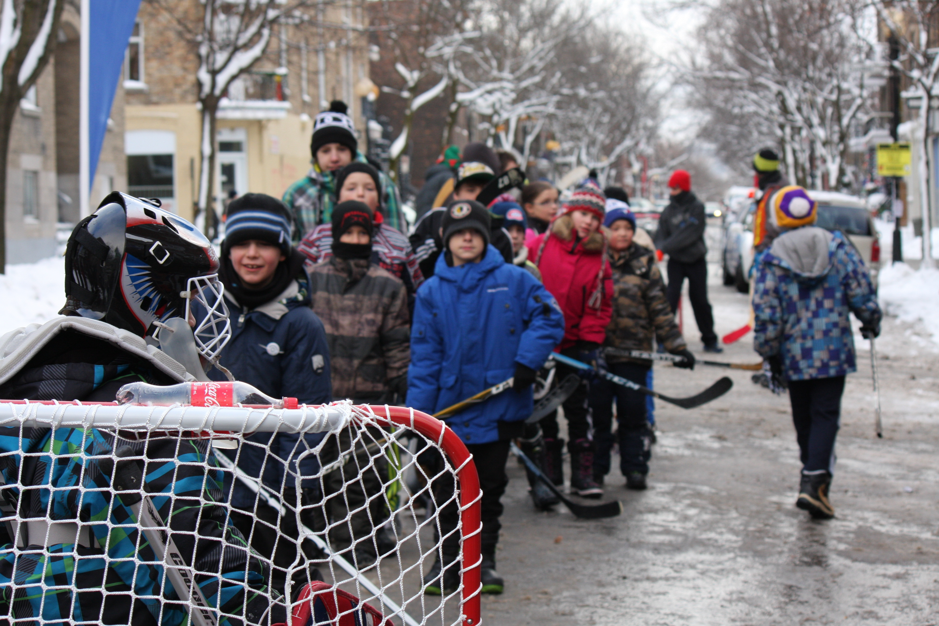
Empowering the child & family and the community
no. 6
SUCCESS
Self-esteem
Confident
Secure
Balance
S
S
S
Experience
ATTACHMENT
IDENTITY
RESILIENCE
LOSS
L
School Drop out
Exclusion
Suicide, Chronic Health Diseases
L
L
Development Pathway
© All rights reserved, Fondation Dr Julien, Child’s Rights Approach to Child Health, October 2023
Notes:
Gilles 9

Slide 19





The Canadian Community Social Pediatrics Model
A Comprehensive Child-Rights Approach to Health for Powerful Outputs
Accessibility to a transdisciplinary team
within the community
Early identification and stimulation
of all vulnerable children( Diagnosis?)
Environments adapted for maximum child participation
keeping them engaged and motivated as ambassadors and persons with power
Powerful protective circle shaped for each child with all people acting around the child
Access to all needed support to maintain brain and genetic integrity (gene interactions)
for a better life outcome
© All rights reserved, Fondation Dr Julien, Child’s Rights Approach to Child Health, October 2023

Slide 20
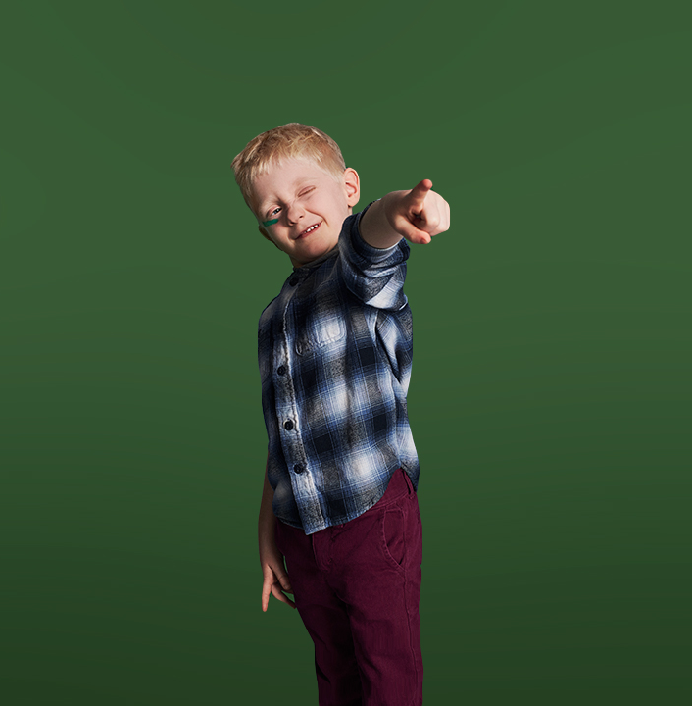
The Community Social Pediatrics/outcomes
Empowered children and families
Stronger communities
No child falling into cracks
Social equity
Brain integrity
Better future for all
© All rights reserved, Fondation Dr Julien, Child’s Rights Approach to Child Health, October 2023

Slide 21

The Community Social Pediatrics Approach –
A Powerful Tool
A Comprehensive Approach to Health
Integrating medicine, law and social sciences.
A Unique Clinical Method
(proximity and respect as powerfull tools)
Establishing a spec
Exchanging
Decoding
Action))
Ensuring the child’s participation, every step of the way
Creating Protective Circles
Leveraging the child’s strengths together with the resources of their family, the key people in their life and their community.
A Transdisciplinary Environment
Engaging the child, its family and community members hand in hand with CSPC professionals.
© All rights reserved, Fondation Dr Julien, Child’s Rights Approach to Child Health, October 2023
Notes:
Voici la nouvelle diapo de Dr Julien:
A rallying cry for the future of vulnerable children
A response for the Tragedy of preventable brain damage in numerous young children
The innovative APCA method in Community social pediatrics based on the UN convention of the rights of children and on evidence-based science
4 steps:
A for attachement and trust (how to be)
P for problem sharing and decoding to deepen into the causes
C for a comprehensive transdisciplinary approach (medical, legal, social sciences, family and child as full partners)
A for action to be created out of the box by all participnts in a consensus mode (how to do)

Slide 22


With our Institute of Community Social Pediatrics we nourish and share best practices
Education
Certification of Centres & Accreditation of Practitioners
Research & Evaluations
University training courses in community social pediatrics (within CSPC)
Continuing Professional training by e-learning modules, bilingual-accreditation program for trainers recognized by various professional colleges & universities
Children Link to Adult & Networks (CLAN) training modules in the community for children & adults ( children’s pacific communicators & social entrepreneurs; adults building a safety net
PARTNERS for Research in Community Social Pediatrics
TWO chairs in Community Social Pediatrics
Certification Program for Community Social Pediatric Centres
Certification Program for Practitioners (forthcoming)
Social return on investment, pilot phase 2016-2019
Effects of CSP interventions, pilot phase 2016-2019
© All rights reserved, Fondation Dr Julien, Child’s Rights Approach to Child Health, October 2023
Notes:
Helene 7

Slide 23

45 Community Social pediatric centers in Quebec and Canada since 1997 (and ongoing)
45 Centres
+ 2 outisde Québec
23 Centres
2017-
13 nouveaux centres
16 Centres
2015-2016
7 nouveaux centres
Argenteuil
Laval (Pont-Viau)
Magog
Pierrefonds
Longueuil (Lemoyne)
Shawinigan
Ste-Agathe
Nouvelle-Beauce
Haute-Yamaska Granby
Mont-Laurier
Longueuil Sacré-Coeur
Sud-Est (NB) Vanier (ON)
13 Centres
2013-2014
3 nouveaux centres
St-Hyacinthe
Drummondville
Hull
Appalaches
St-Laurent / Chameran
Lanaudière (Joliette)
Laval (Chomedey)
8 Centres
2011-2012
5 nouveaux centres
Lanaudière (Cherstey)
Cowansville
Whapmagoostui
2 Centres
2009-2010
6 nouveaux centres
Laval St-Martin
Lévis
Haute-Gaspésie
Québec
Verdun
1997-2008
2 Centres (FDJ)
Centre-Sud (Mtl)
Gatineau
Trois-Rivières
St-Laurent
Haut-Richelieu
Garage à musique (Mtl)
Hochelaga-Maisonneuve
Côte-des-Neiges
CPSC en démarrage
St-Léonard d’Aston
Vallée-de-la-Gatineau
Rimouski-Neigette
St-Jérôme
Gaspé Rivière-au-Renard
Manawan
Lachine
© All rights reserved, Fondation Dr Julien, Child’s Rights Approach to Child Health, October 2023
Notes:
Gilles 9

Slide 24


http://agiteur.com/graphiques-evolution-positive-monde/
https://institutpediatriesociale.com
THANK YOU!
https://drjulien.blog/
© All rights reserved, Fondation Dr Julien, Child’s Rights Approach to Child Health, October 2023

