Slide 1
The Child Rights Impact Assessment (CRIA) tool and E-learning course
2023-10-10

Slide 2
Overview
United Nations (UN) Convention on the Rights of the Child (CRC) and Canada’s obligations
Appearances Before the UN Committee on the Rights of the Child and Recommendations on CRIA
How Justice Canada Developed the CRIA Tool and Course
Overview of the CRIA Tool
Overview of the CRIA Course
Interaction with GBA+ and Future of CRIA
Questions?

Slide 3
United Nations Convention on the Rights of the Child
Convention on the Rights of the Child (CRC) adopted in 1989
CRC ratified by Canada in 1991
Ratified by 196 countries
CRC has four guiding principles:
  Non-discrimination (art 2)
  Best interests of the child (art 3; 21)
  The right to life, survival and development (art 6)
  Respect for the views of the child (art 12)

Slide 4
UNCRC and Canada’s Obligations –Implementation
The implementation of a treaty is an ongoing process
Under Article 4 of the CRC, States Parties shall undertake all appropriate legislative, administrative, and other measures for the implementation of the rights recognized in the CRC
The Committee’s General Comment No.5 provides guidance to States Parties on general measures of implementation and recommends the use of CRIA

Slide 5
Appearances Before the Committee and Recommendations
Canada’s appearance before the Committee - May 17-18, 2022
The Committee publicly released its Concluding Observations for Canada - June 9, 2022
While non-binding, the Committee expects Canada to seriously consider its recommendations

Slide 6
How Justice Canada Developed the CRIA Tool and Course
CRIA initiated by Justice Canada’s Human Rights Law Section and Family Law and Youth Justice Policy Section
An Advisory Group comprised of key stakeholders was created to provide feedback on the content of the CRIA tool and course
Justice Canada launches the CRIA tool and course in July 2023

Slide 7
Overview of the CRIA Tool (1)
The CRIA is an impact assessment tool that looks like the Gender Based Analysis Plus (GBA+), but where the focus is on the needs of children between age 0-18
Primarily designed to help federal officials identify and consider all potential direct or indirect effects that a proposed law, policy, program or other initiative can have on children’s rights
Our CRIA tool is based on the text of the UN Convention on the Rights of the Child – requires a certain understanding of Canada’s obligations under the CRC

Slide 8
Overview of the CRIA Tool (2)
Why use a CRIA?
Children are a vulnerable group that does not generally have the opportunity to either:
1. Play a significant part in political processes as they do not have the right to vote or stand for political office; or
2. Engage in other processes that may influence public policy.
Considering the impacts of initiatives on children is important to ensure that their best interests are protected and that their perspectives are taken into account

Slide 9
Overview of the CRIA Tool (3)
The tool contains two parts (or steps):
Part 1: Initial Screening
Question 1: Objective of the initiative
Question 2: Impact of the initiative
Part 2: Full CRIA
Question 3: Preliminary rights review
Question 4: Information and research
Question 5: Engagement
Question 6: Rights Analysis
Question 7: Weighing of Positive and Negative Impacts
Question 8: Conclusion
Users are encouraged to apply a CRIA as soon as possible when they develop a new initiative!

Slide 10
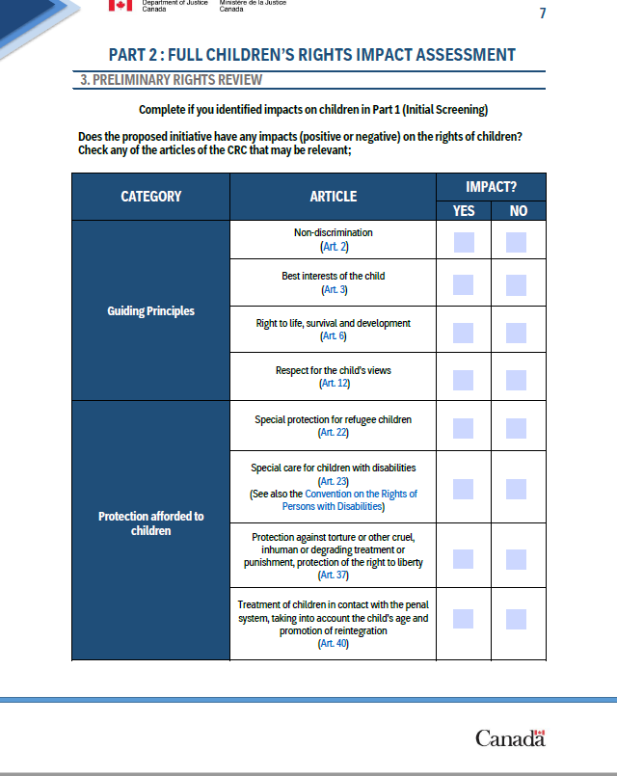
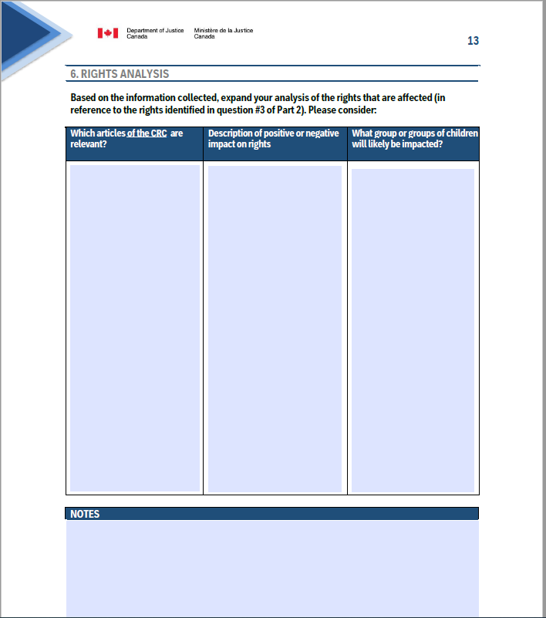
Overview of the CRIA Tool (4)

Slide 11
Overview of the CRIA Course (1)
Available to all public servants, but also to the public
Includes an introduction to international human rights law, an overview of the CRC, an explanation of key concepts and the rationale of a CRIA, and two case studies for participants to apply their knowledge
Length: 2.5 to 3 hours
Language: available in French and English
Interactive, self-paced

Slide 12
Overview of the CRIA Course (2)
Our goal was for the users to understand the context behind the CRIA and how to best use it
The tool provides a lot of examples
We have also worked closely with experts in Indigenous law within the Department of Justice to correctly incorporate considerations for Indigenous children

Slide 13
Overview of the CRIA Course (3)
Example of specific considerations: How we addressed Indigenous children's considerations in the course:
  Slides on the role of Indigenous Governments in the implementation of the CRC
  Slides on the protection afforded to Indigenous children within the CRC (articles 30, 17, 29, 8)
  Slides on the special attention required in the application of the best interests of the child principle in relation to Indigenous children (including unique factors to be considered: ongoing relationship with family, cultural identity and language etc.)
  Slides on the importance to consider Canada’s obligations under the United Nations Declaration on the Rights of Indigenous Peoples
  Concrete examples of initiatives that could have an impact on Indigenous children and how the CRIA could be applied

Slide 14
Overview of the CRIA Course (4)
The course contains two case studies, where participants are invited to apply a CRIA:
  The Canada Food Guide
  Remote Testimony Rooms

Slide 15
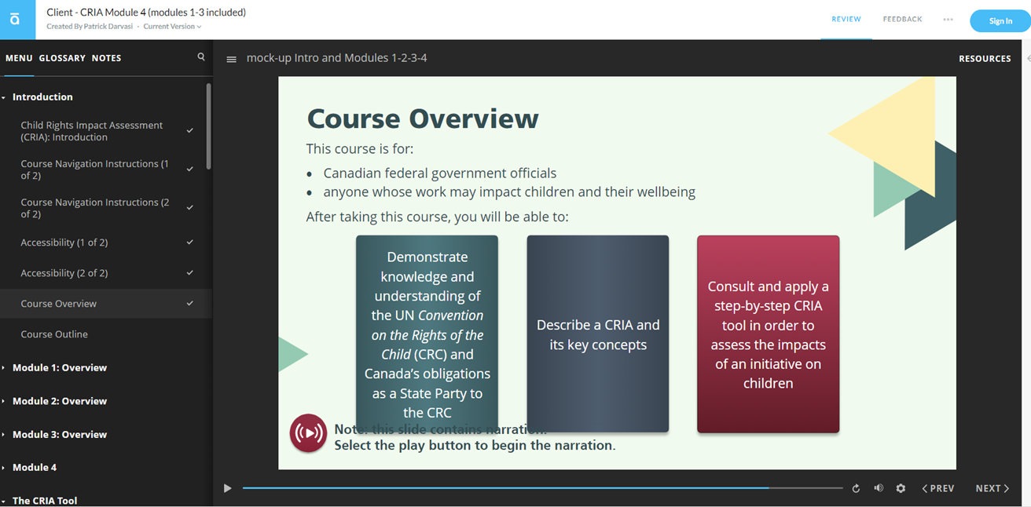
CRIA Online Course

Slide 16
Interaction with Gender-Based Analysis Plus
What is GBA+?
Tool to assess how diverse groups of women, men, and gender diverse people may experience policies, programs and initiatives.
The “plus” acknowledges that we all have multiple intersecting characteristics, such as race, ethnicity, religion, age, and mental or physical disability, and how the interaction between these factors influences the way we might experience government policies and initiatives.
Age already a factor to consider, but not central to GBA +
CRIA can complement and complete a GBA+ analysis

Slide 17
Promotion across the federal government and beyond
The CRIA tool and course launched in July 2023
For now, it is voluntary within Justice Canada and other departments, but strongly encouraged
Promotion done across our networks, such as the Interdepartmental Working Group on Children’s Rights
Our tool has been added to the GBA+ compendium
Promotion done on social media to the public

Slide 18
Questions?
Thank you!

